Slide 1

Note: Please Download the Expo Go App to Scan App Demos!
CREATING MOBILE APPLICATION FROM SCRATCH
🎉 🎊 🥳
Kyle D’Souza, July 2021
& My Amazing Students :)

Slide 2
* Please Download the Expo Go App to Scan App Demos.

Slide 3
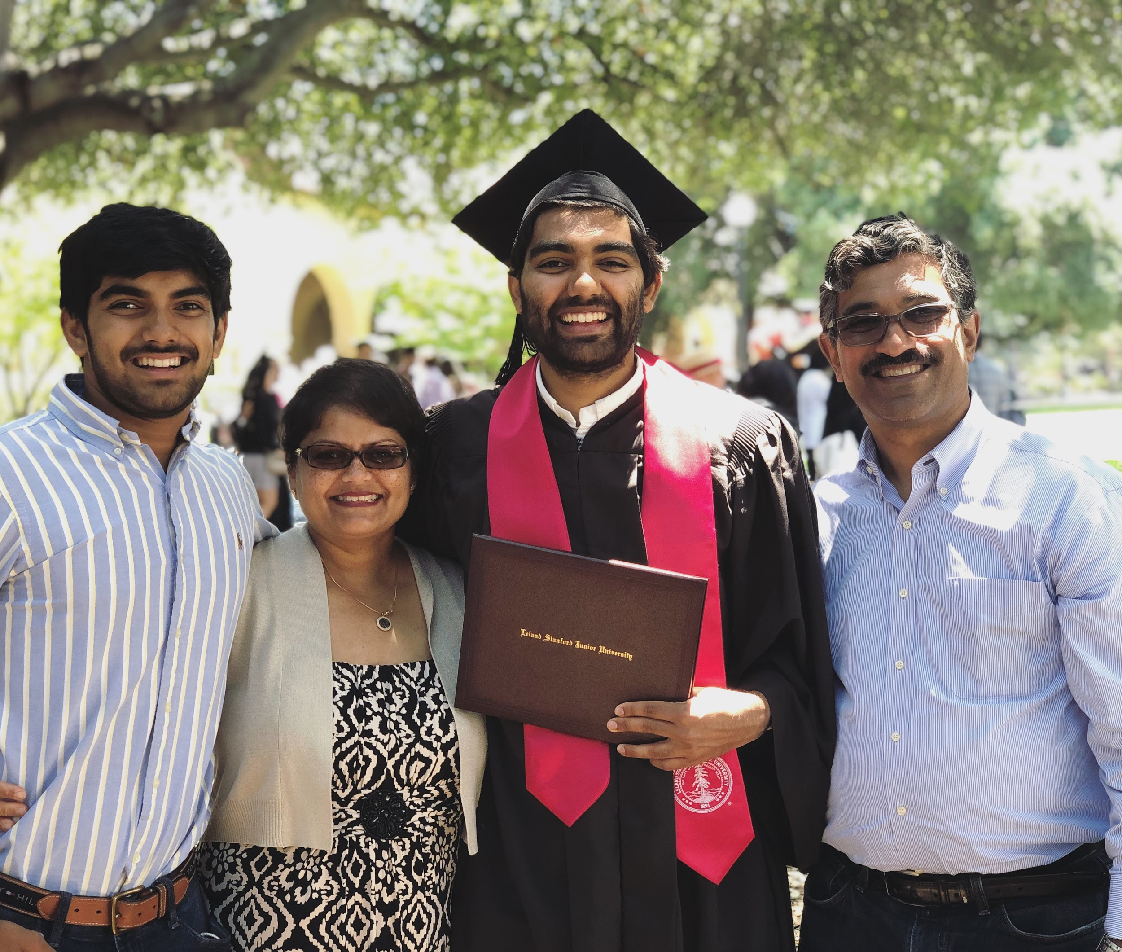
Who am I?
Kyle D’Souza
Lecturer and Graduate Researcher at Stanford
Background: Computer Science (AI, Design, Security)
Past: Microsoft, Cloudflare, Startups
Future: Working as a Product Manager at Microsoft

Slide 4
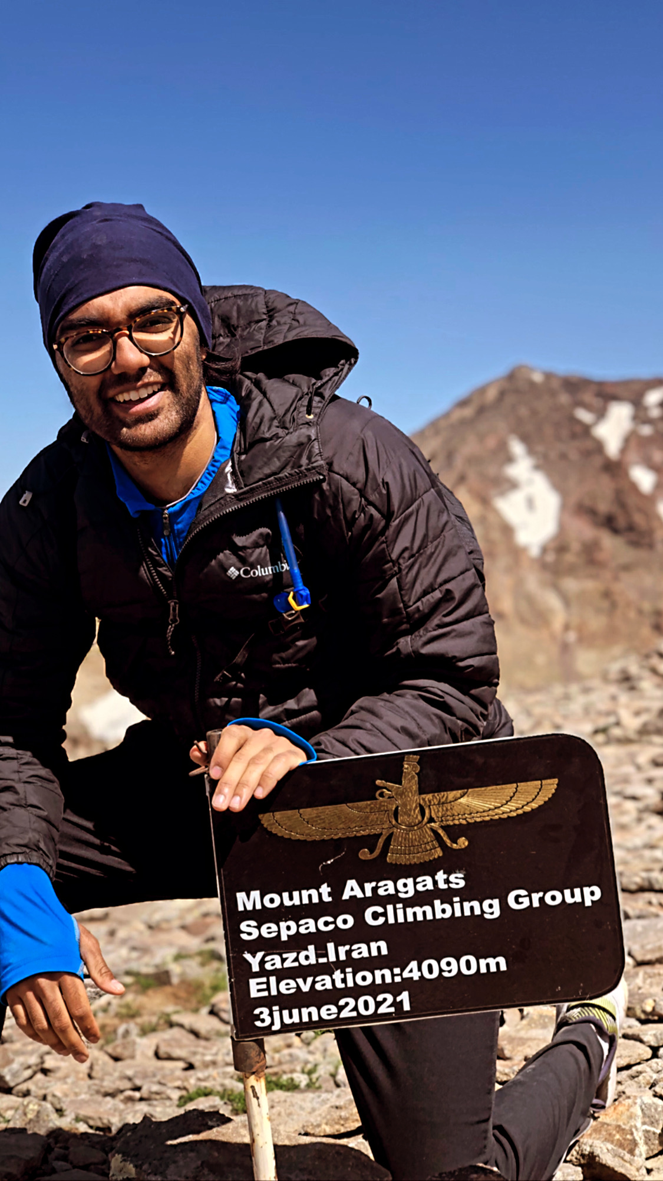
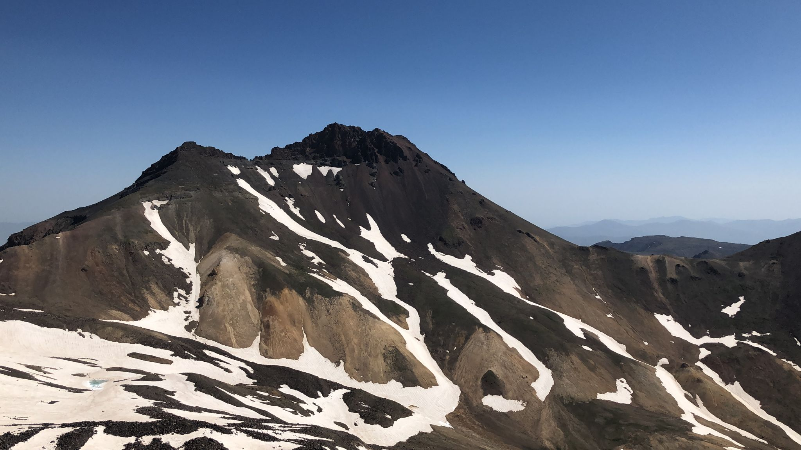
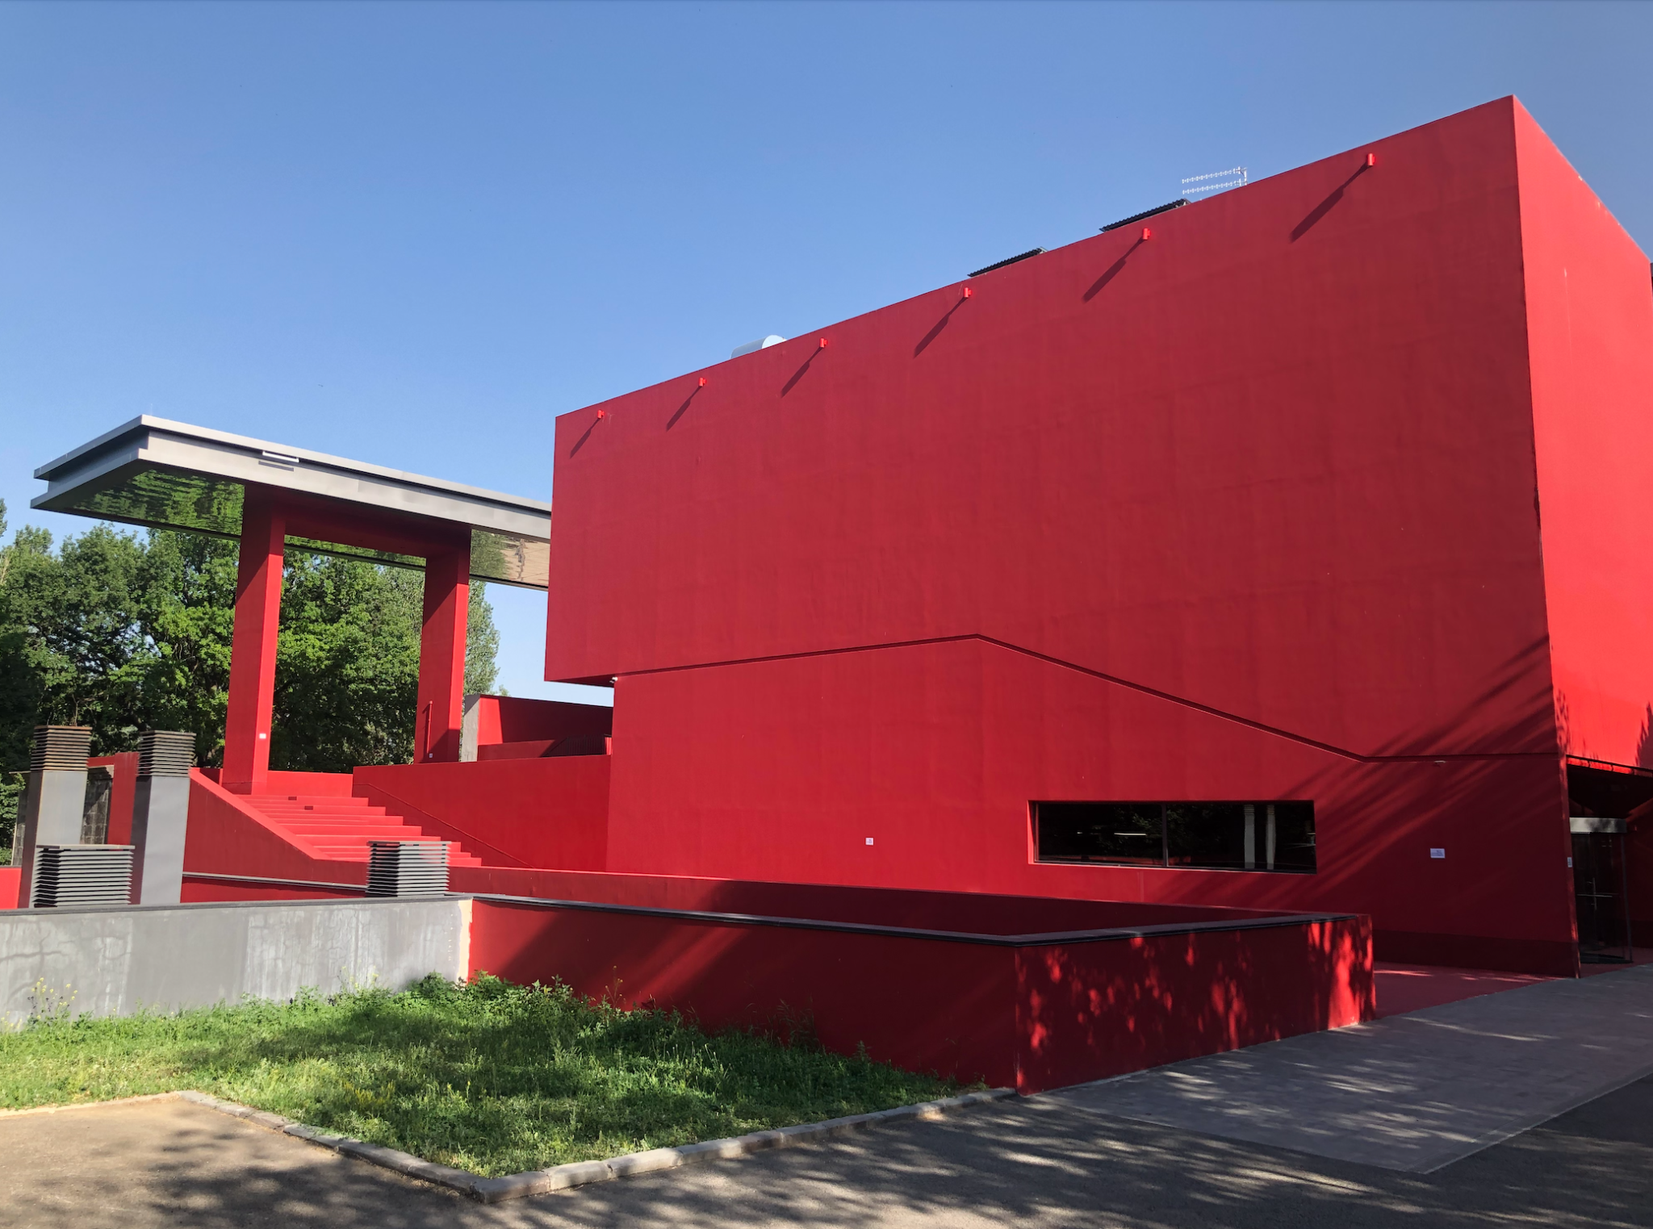
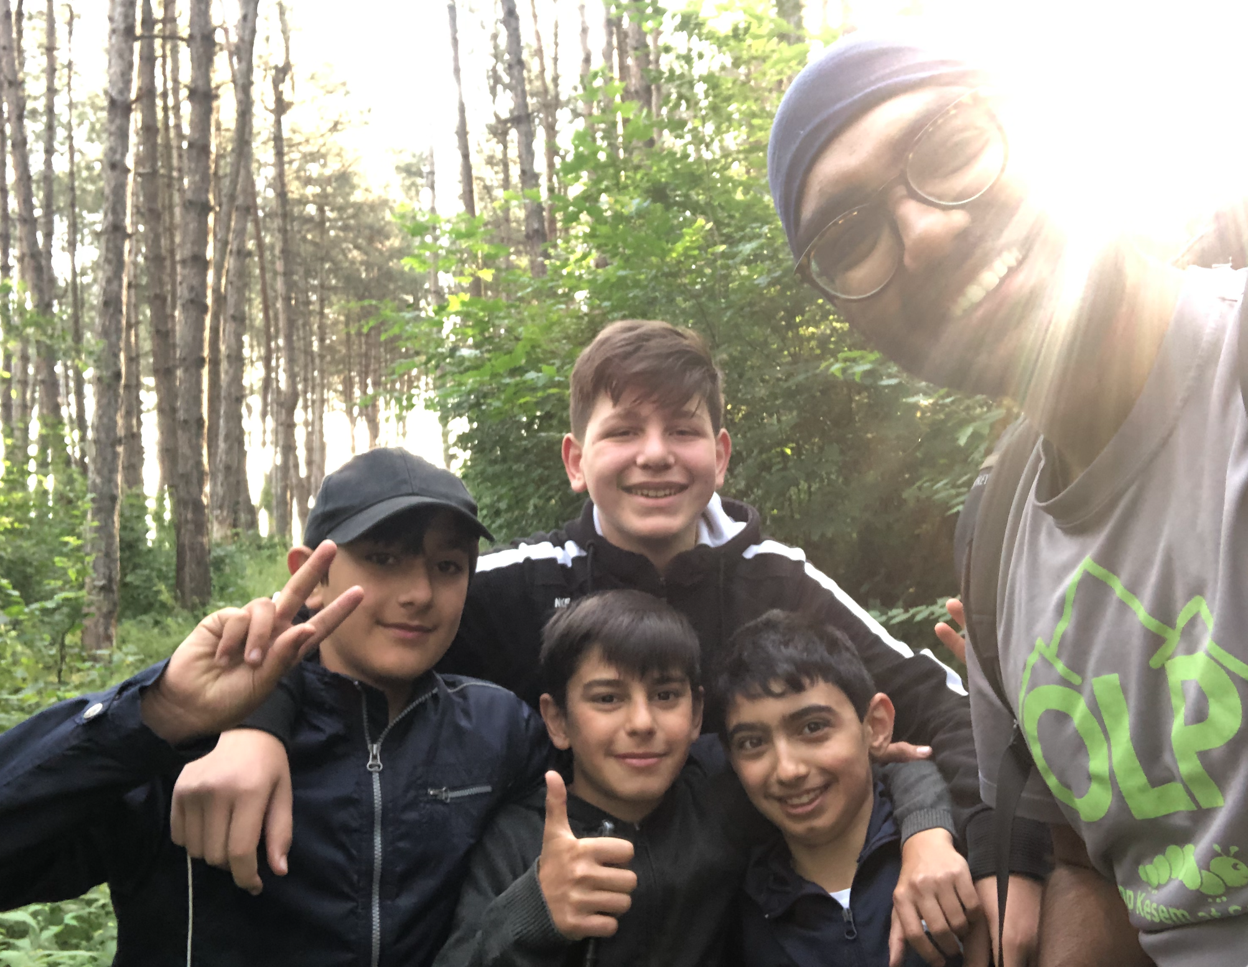
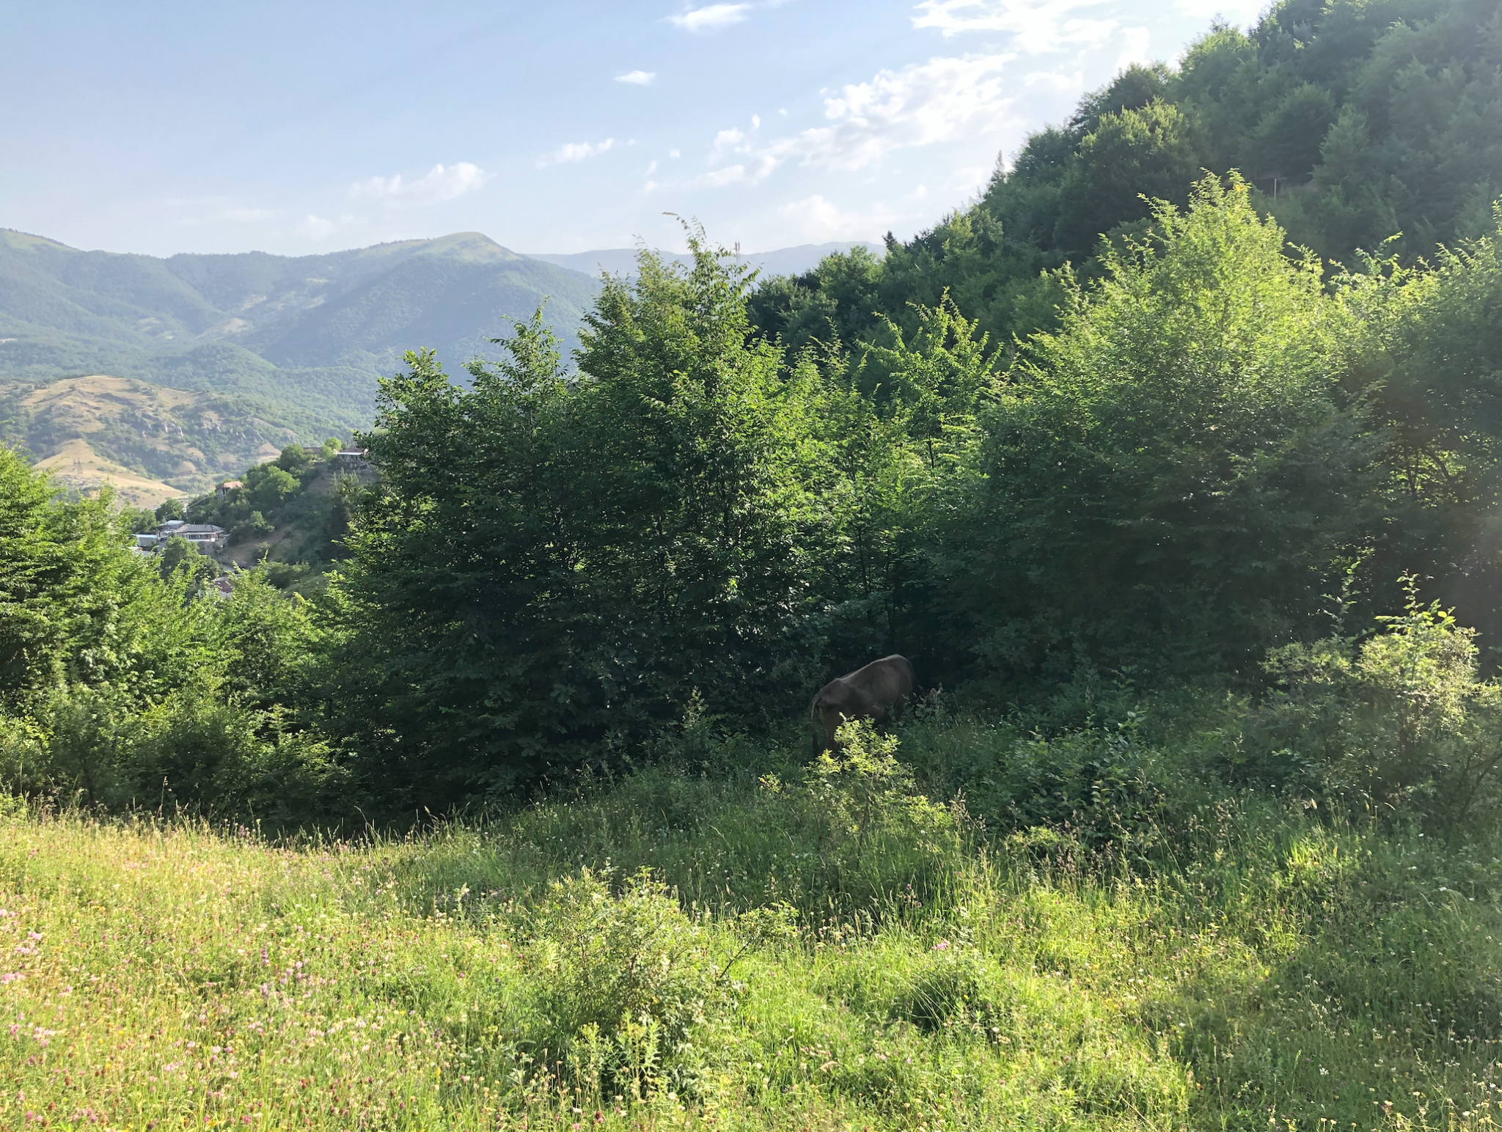
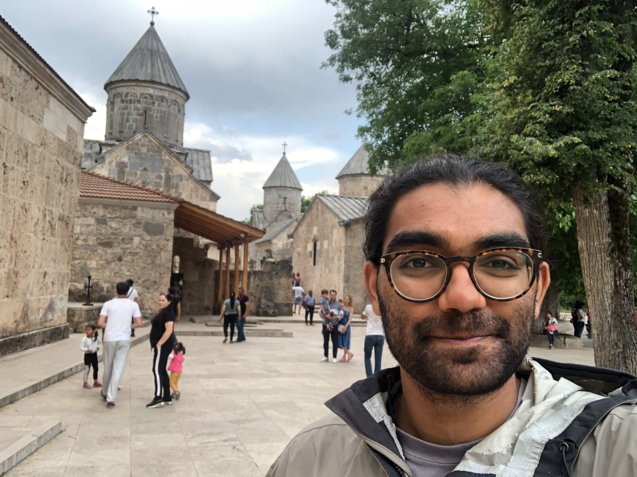
Ես սիրում եմ Հայաստանը

Slide 5
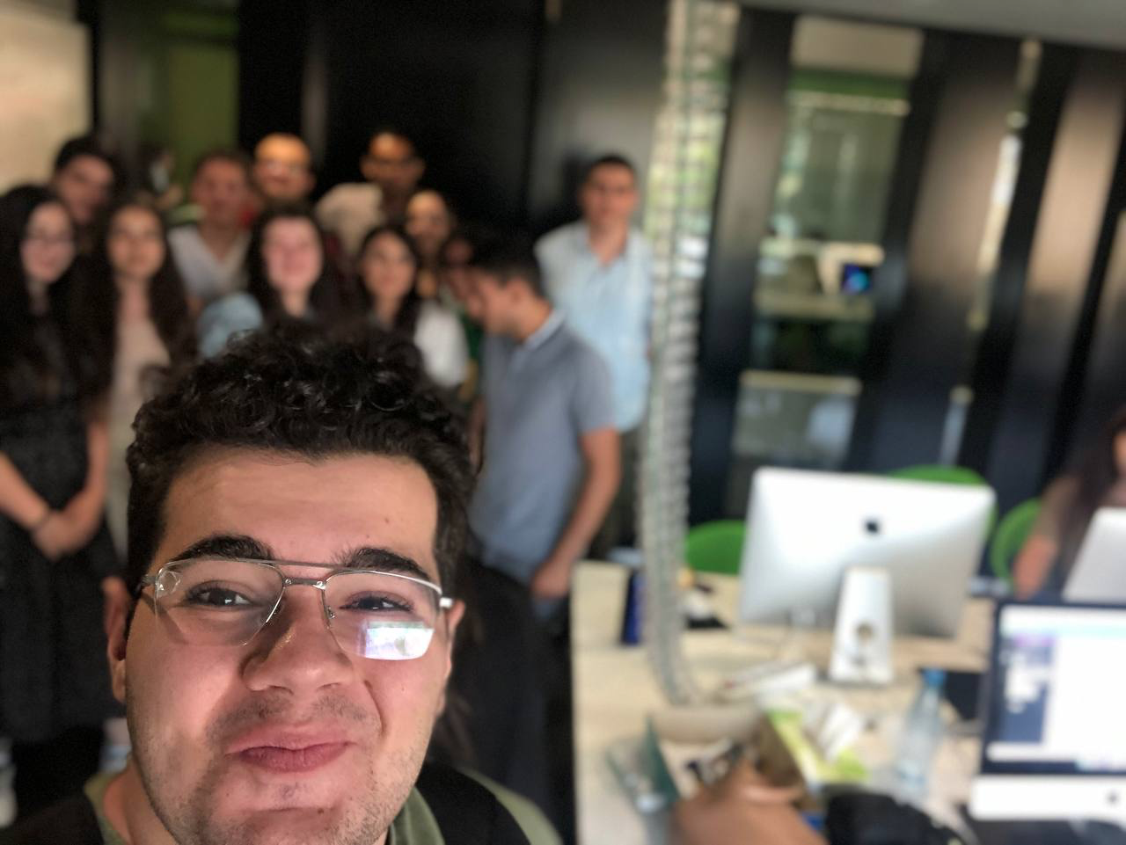
Introduction

Slide 6
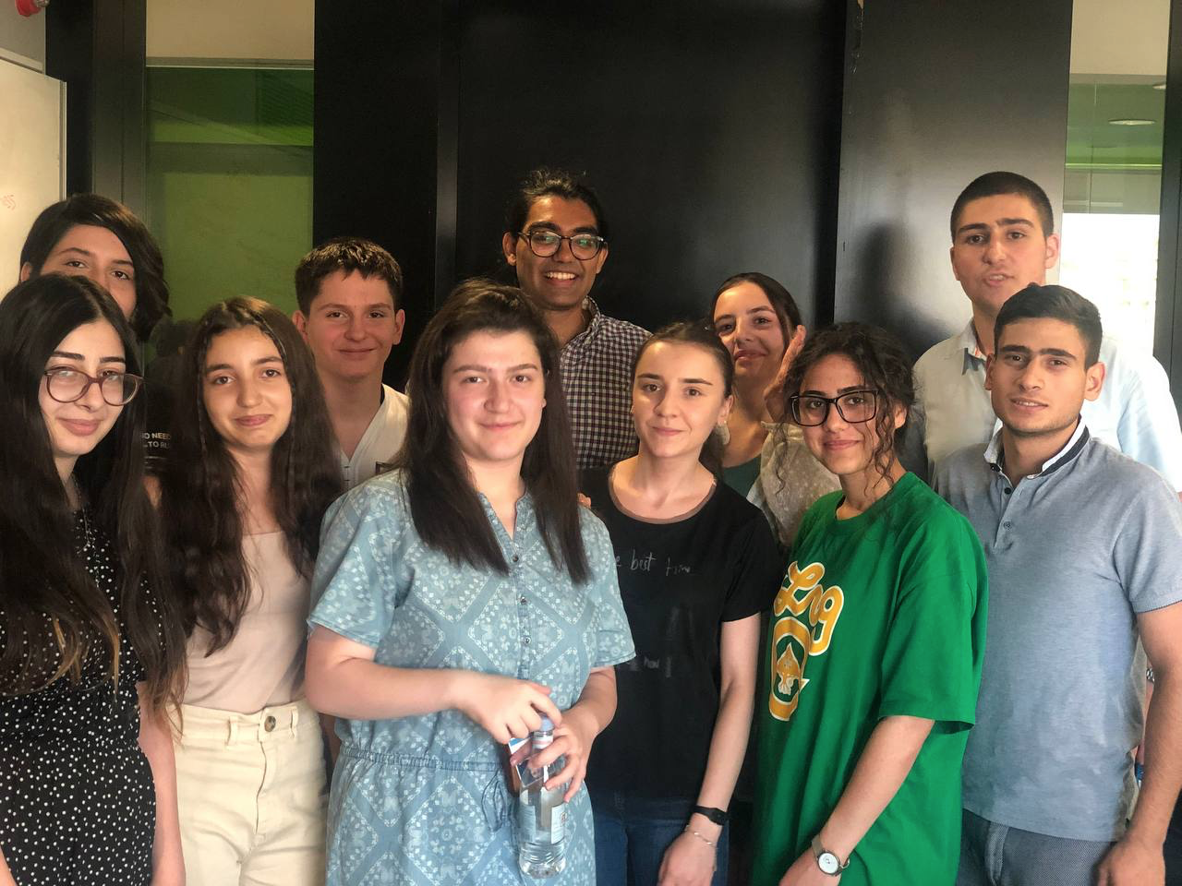
Lab Description
2 Week Lab
Build a mobile application from nothing
First 4 Days: Learn React Native
Build a Profile
The Rest: Design and Build a Product that helps real customers
Students work ethic: 110%

Slide 7
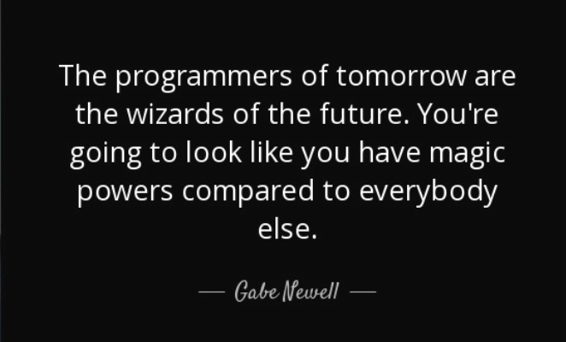

Slide 8
Goal
BECOME the magician :)
INSPIRE to create and put their dreams into reality
UNDERSTAND how to build a product prototype like real industry companies and startups
COMMUNICATE that vision to a broader audience
AND Have Fun and Work Hard!
Notes:
become the wizards

Slide 9
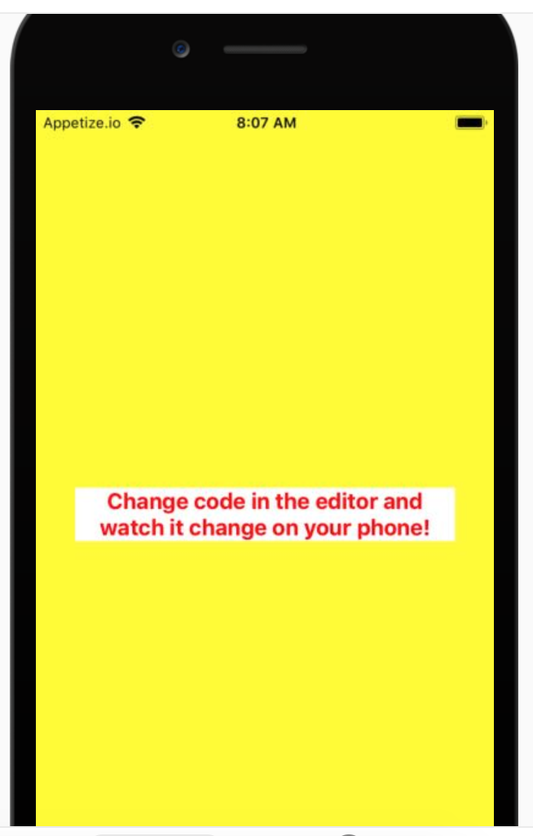
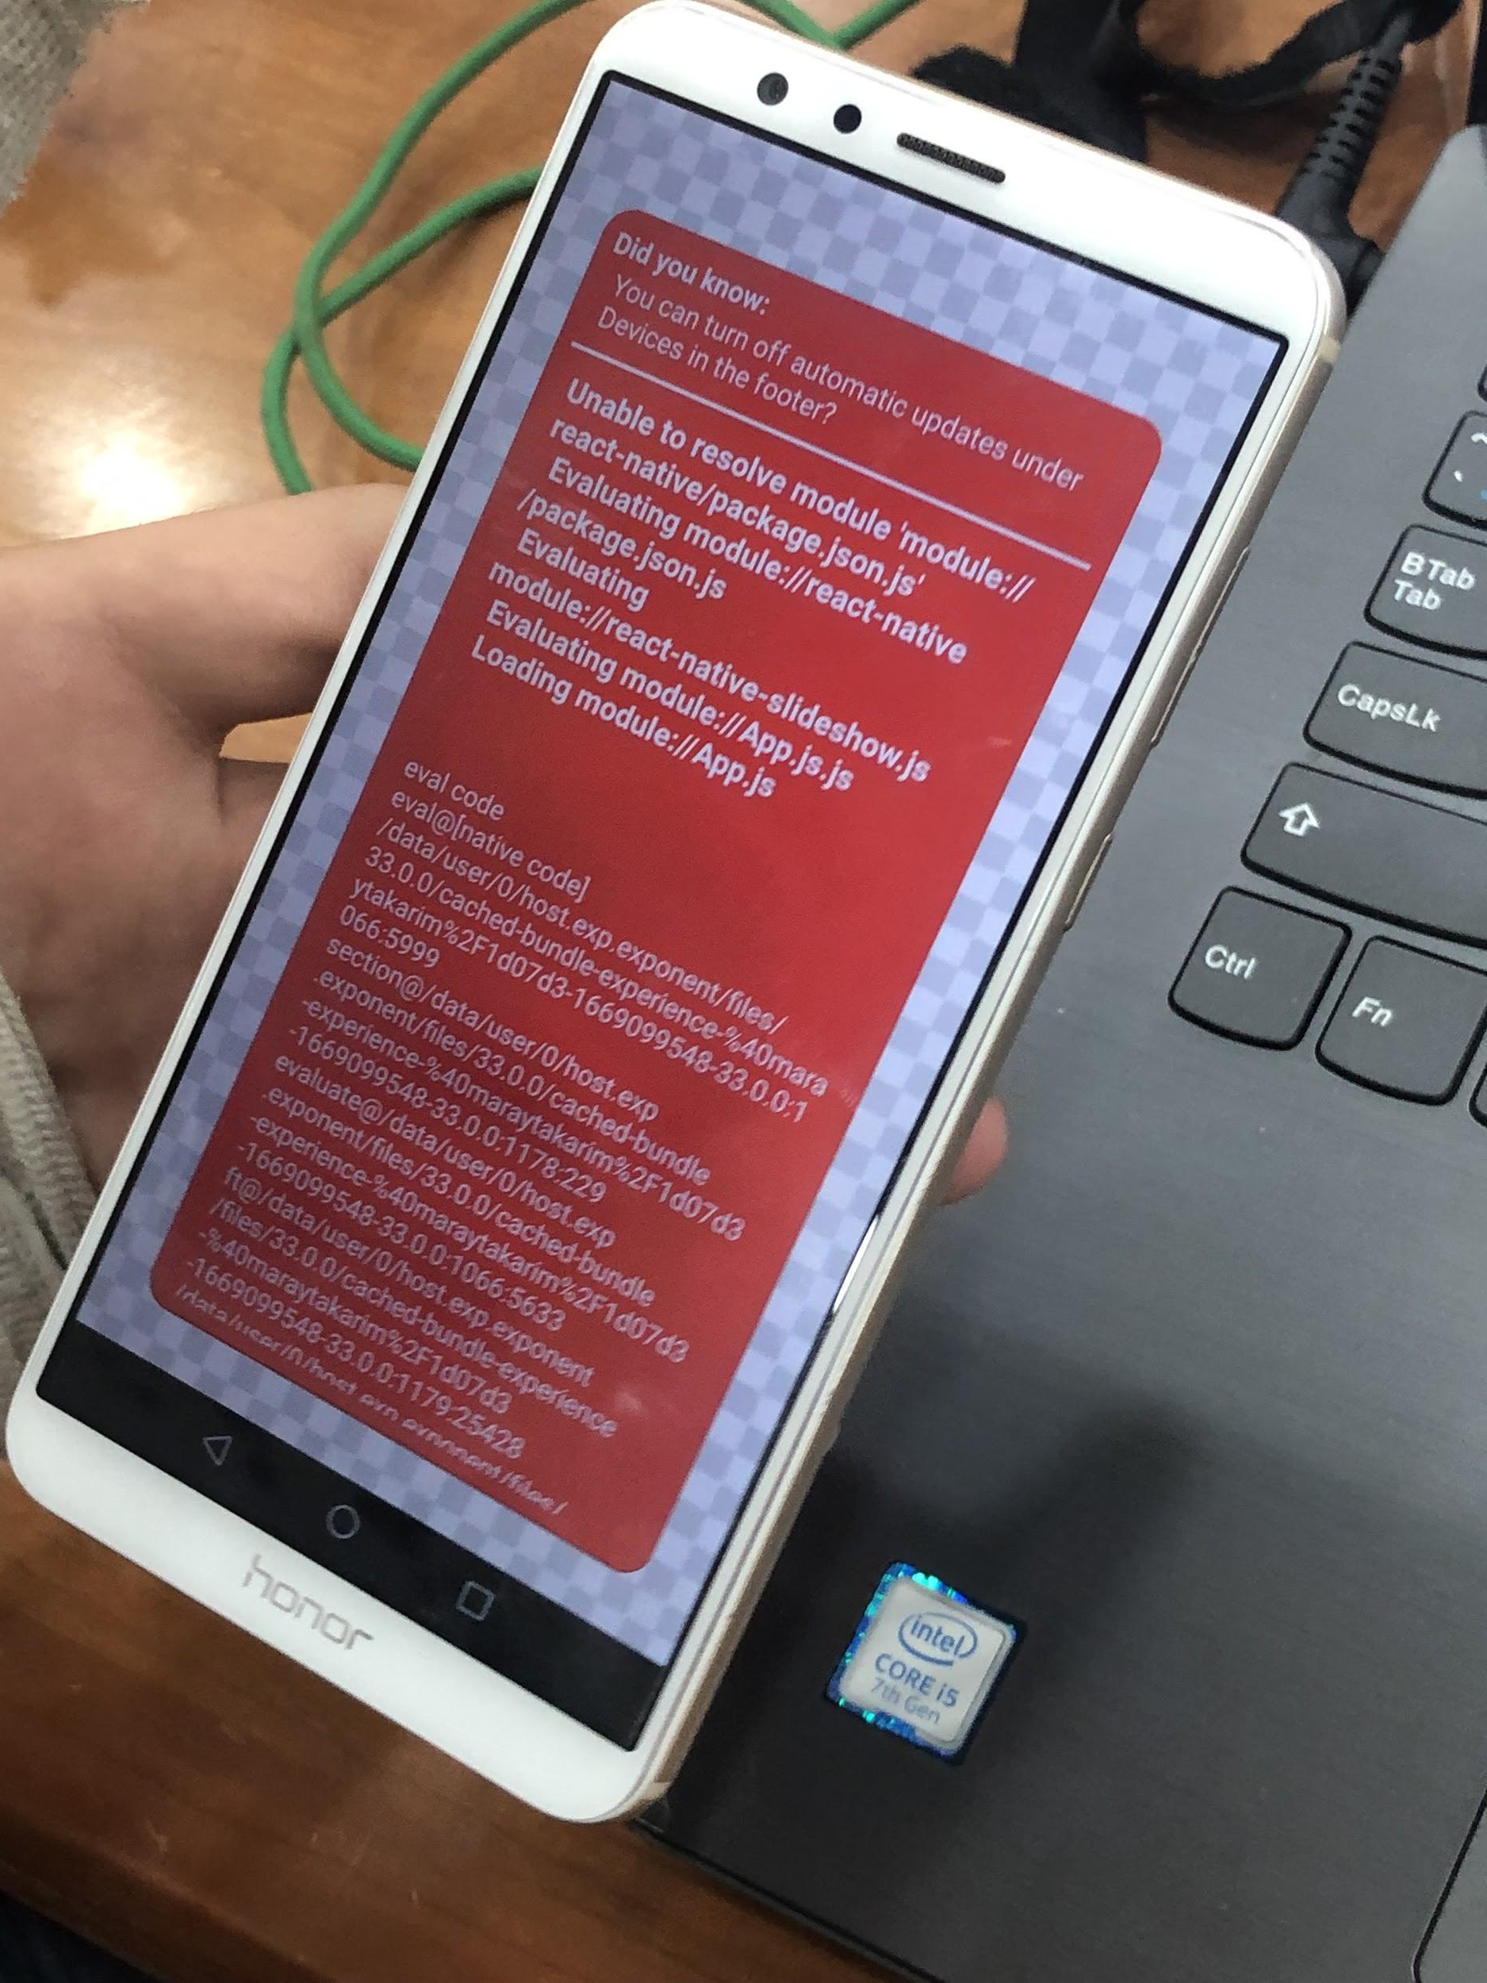
We went from here...
What is React Native?
How to get Text on screens?
How do containers work?
What are components?
How to fix bugs?

Slide 10
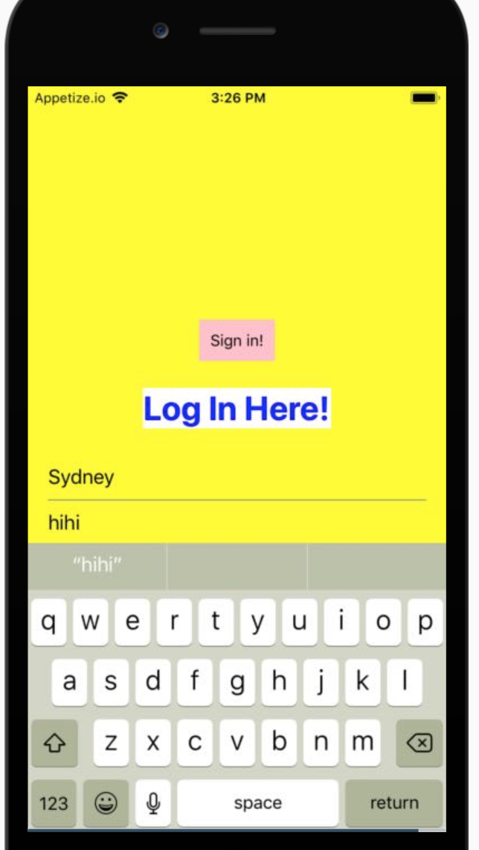
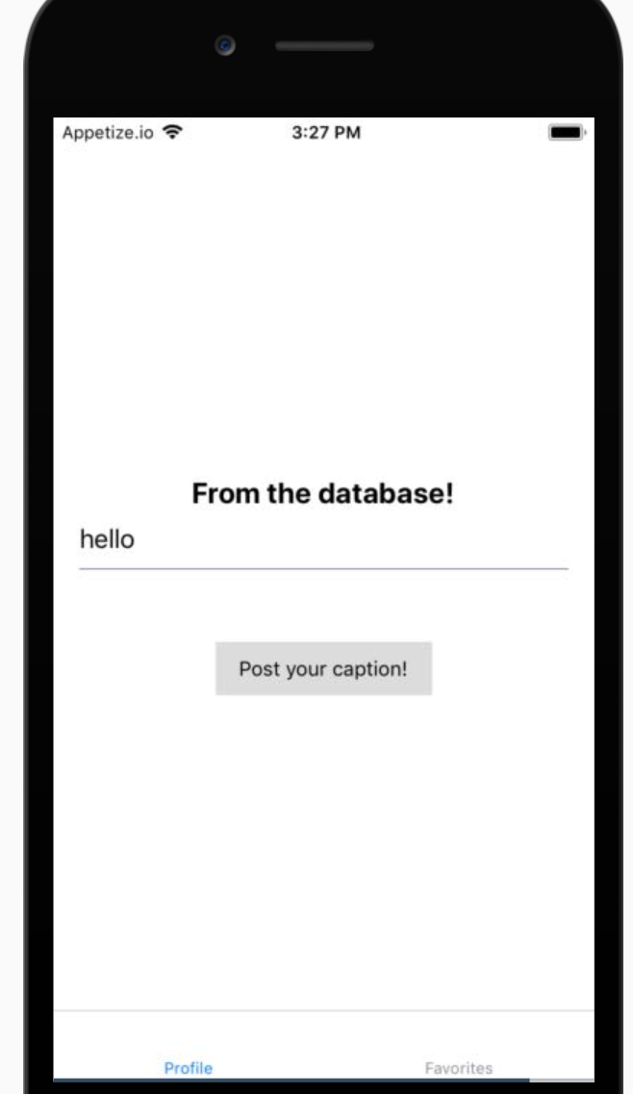
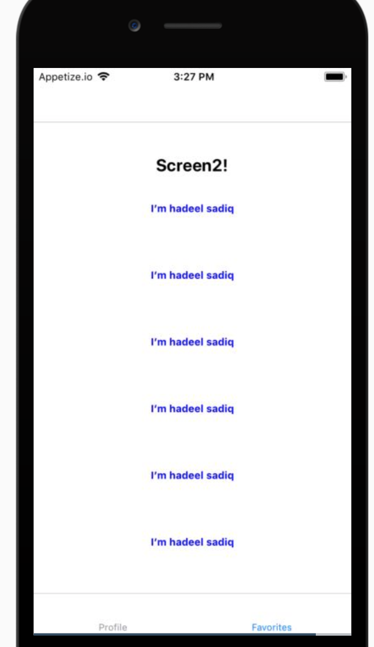
To here...
State and Logins
Databases
FlatLists

Slide 11
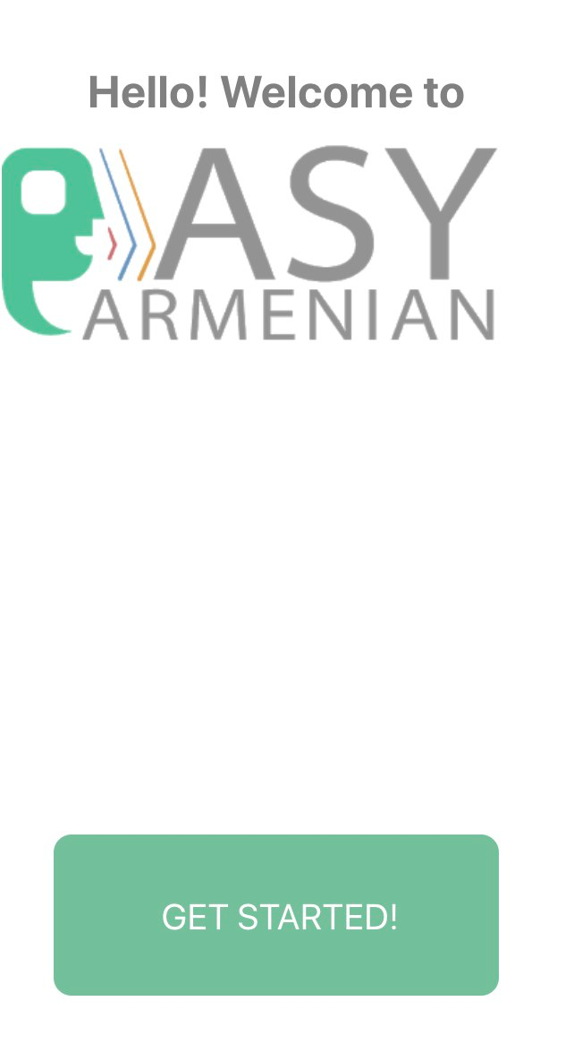
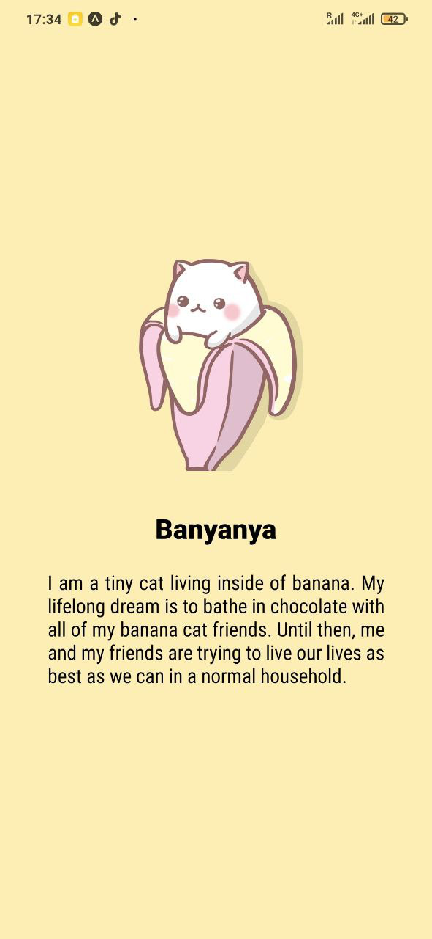
Home Screens

Slide 12
Recap: What Students Learned
Screen Components
View, ScrollView, WebView, Text, Image, TextInput, TouchableOpacity, Button, Camera Roll, FlatList (this is a lot!)
Buttons and State
Functions
Moving Data Between Screens
Navigation
StackNavigation
TabNavigation
Switch Navigation
Integrations
Database (store and save persistent information on the cloud)

Slide 13
Recap: But They Also Learned This
Debugging Skills
React Native
Googling
Front-end Development
Databases/Back End
Teamwork
Problem-Solving
English Practice!
Work Ethic
Resilience
Friendship
Different Types of Music ;)
Programming Maturity
Design Thinking
Wireframing
Designing Creative Solutions!
And built a family <3

Slide 14
Product Design and Ethics
Focused on the MVP - Minimum Viable Product
Artful Design - how do we design responsibly?
Startup Mindset - Building a Vision to Gain Support
3 Designs: Education, Enterprise Technology, Digital Literacy
Notes:
real analogs

Slide 15
Prototype Demos
Notes:
we have three products for you.
One application on digital literacy, another application on easy armenian, and a final application for salata

Slide 16
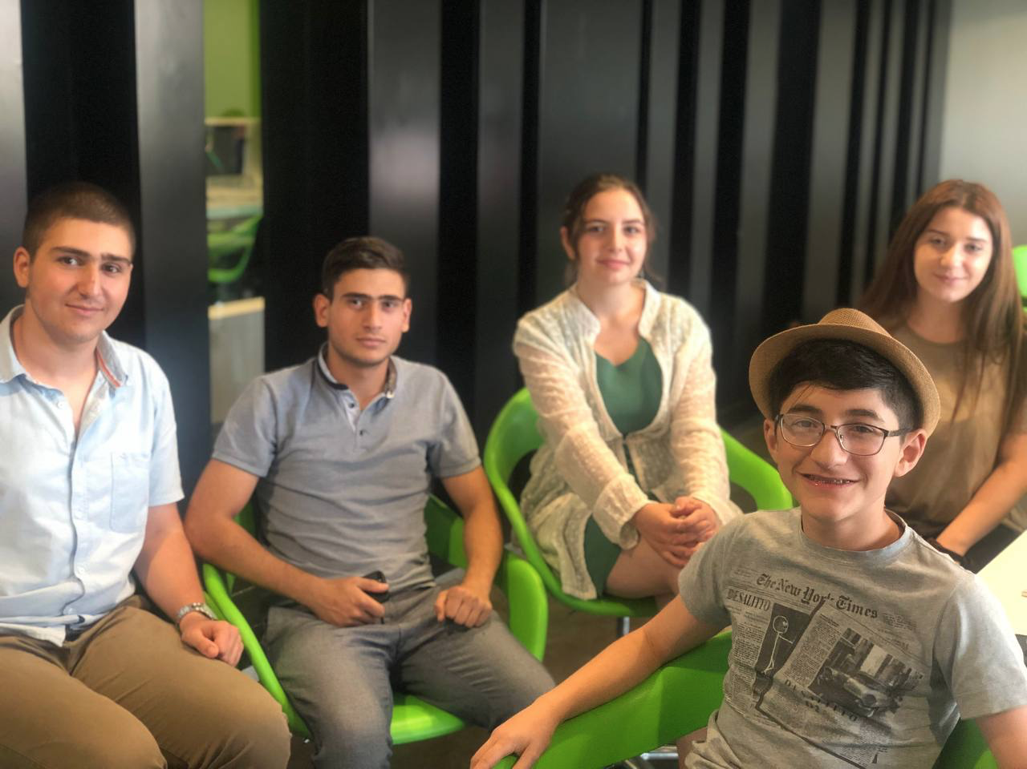
Easy Armenian

Slide 17

Easy Armenian
Kyle D’Souza
Nareh Abrahamyan
Naira Apikyan
David Grigoryan
Vladimir Hovakimyan
Martin Hovhannisyan
Hi Everyone!!
We are the Easy Armenian team. The purpose of this application is to make it easier to learn Armenian.

Slide 18
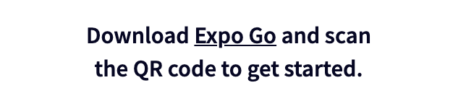
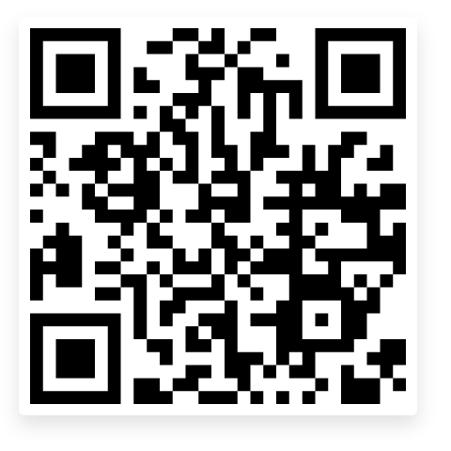
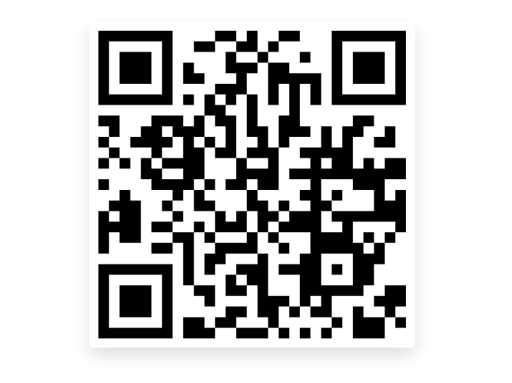
FOR ANDROID USERS
FOR IOS USERS

Slide 19
What problem have we solved?
For who and why?

Slide 20
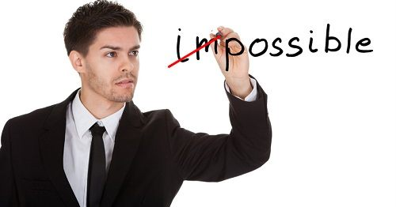
Armenian is one of the hardest languages in the world. It takes 2-3 hours per day to learn basic Armenian. So there was a need of something which could make it easier to learn Armenian for people who want to learn it.
Problem statement

Slide 21

EASY ARMENIAN
So we built the Easy Armenian. The application can be used by every single person who knows English and wants to learn Armenian. And it will take approximately 15-30 minutes per day.

Slide 22
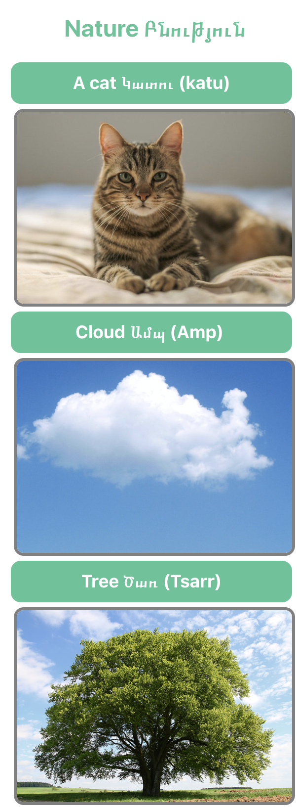
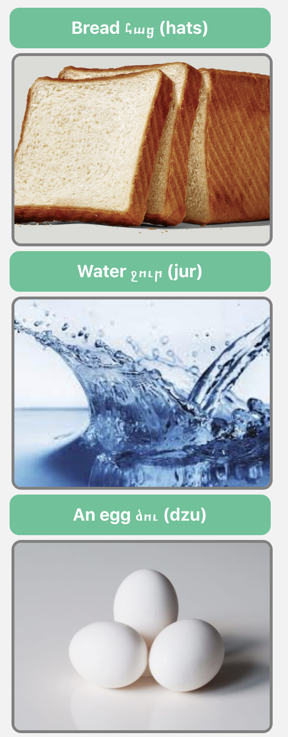
...What are our application’s main features ?..
Food Սնունդ
The Easy Armenian contains images, so the learners can remember the words with their meanings & translations visually.

Slide 23
As you will see in the video the users can pass tests and the lessons several times in order to gain a comprehensive knowledge of the language.

Slide 24
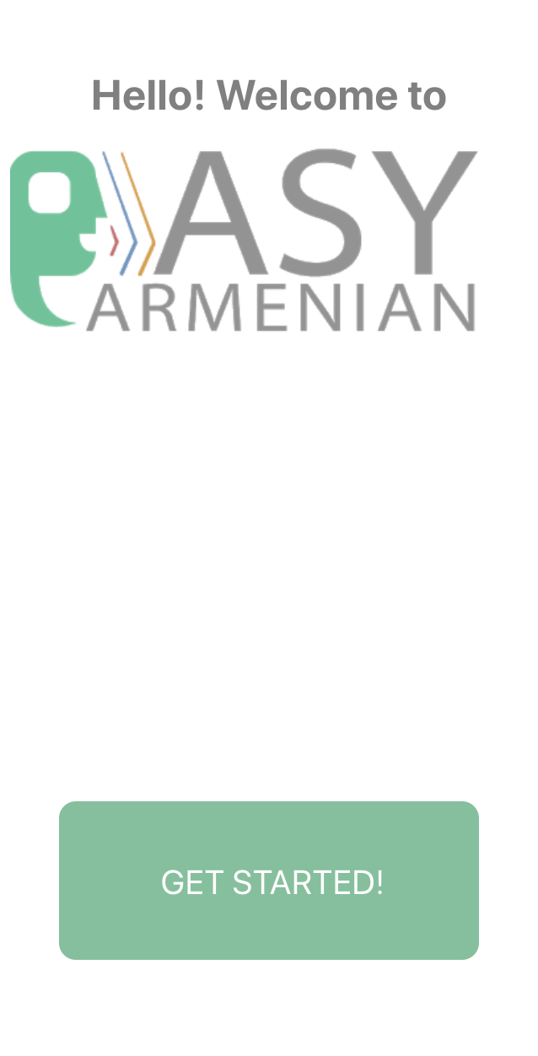

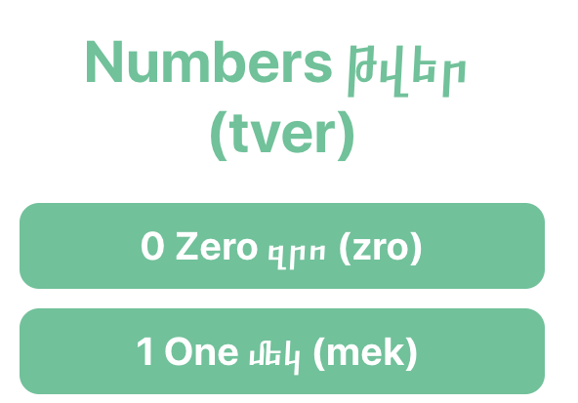
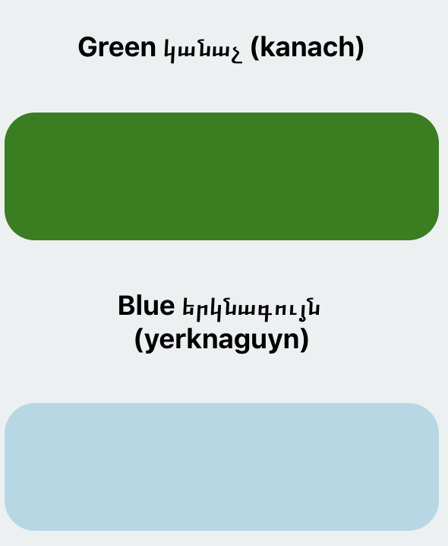


Now a little tour through our application...

Slide 25

Now let’s watch the whole application together !!!

Slide 26
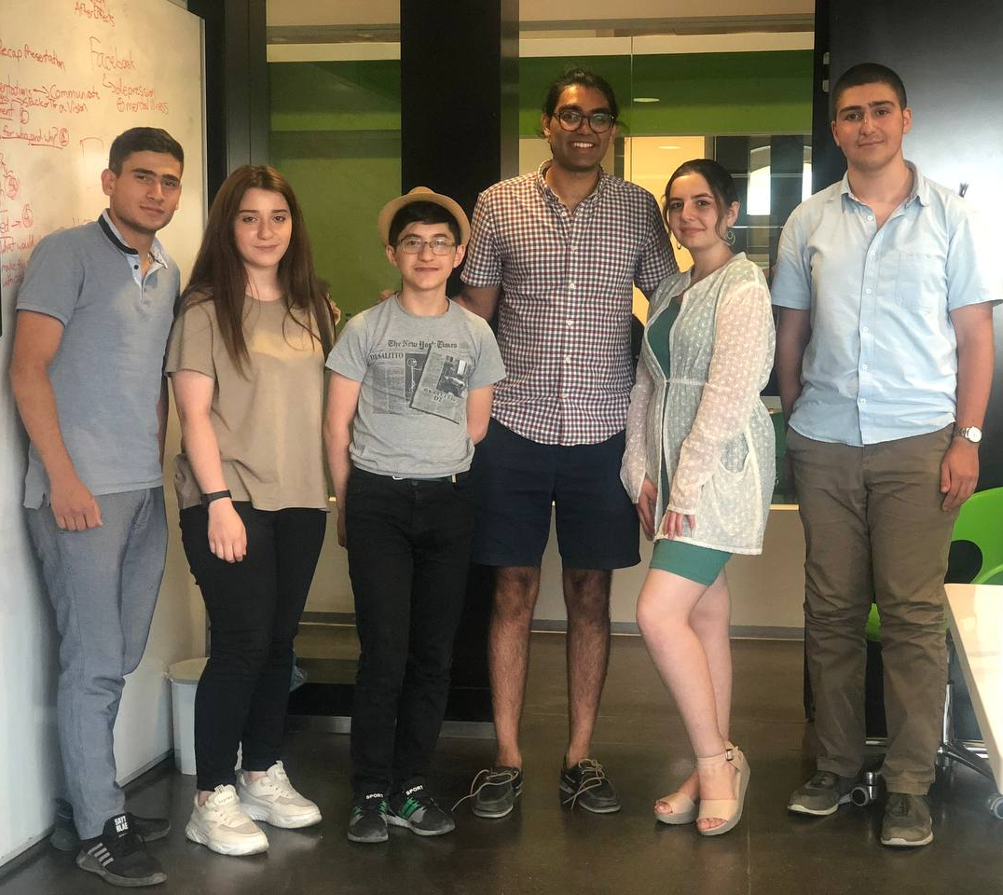
This is our lovely team !
Let’s get acquainted with the members and to know more about who was responsible for what.

Slide 27
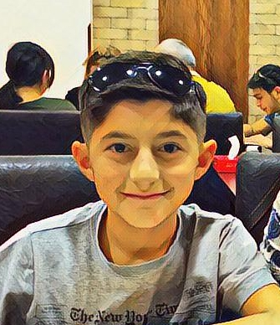
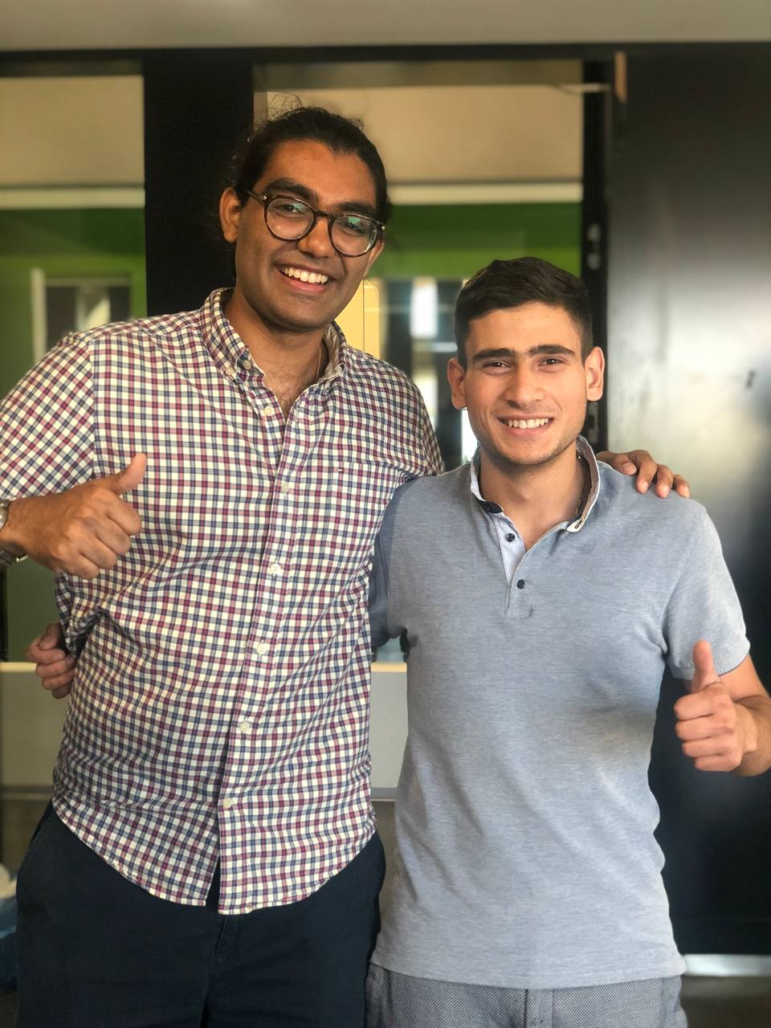
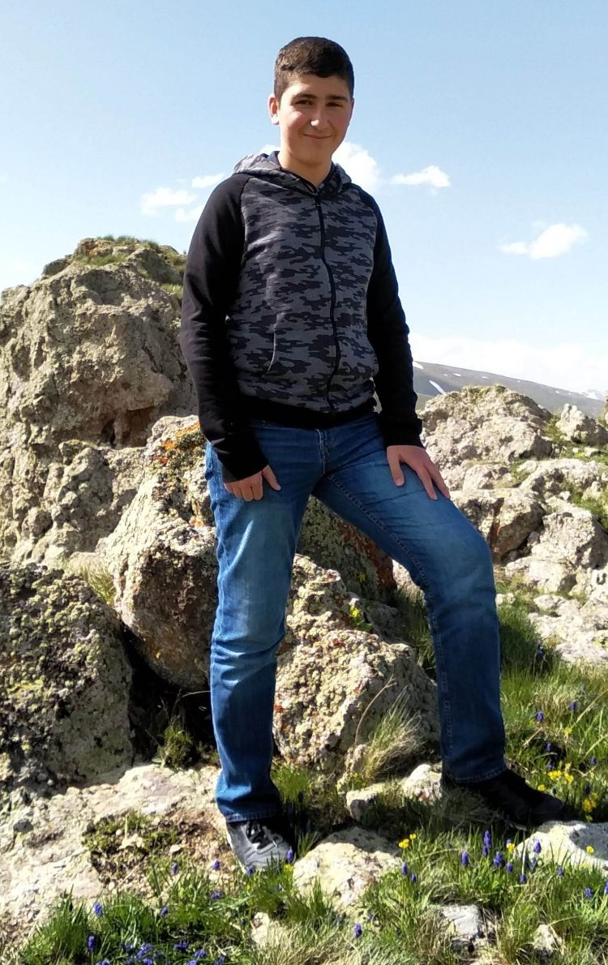
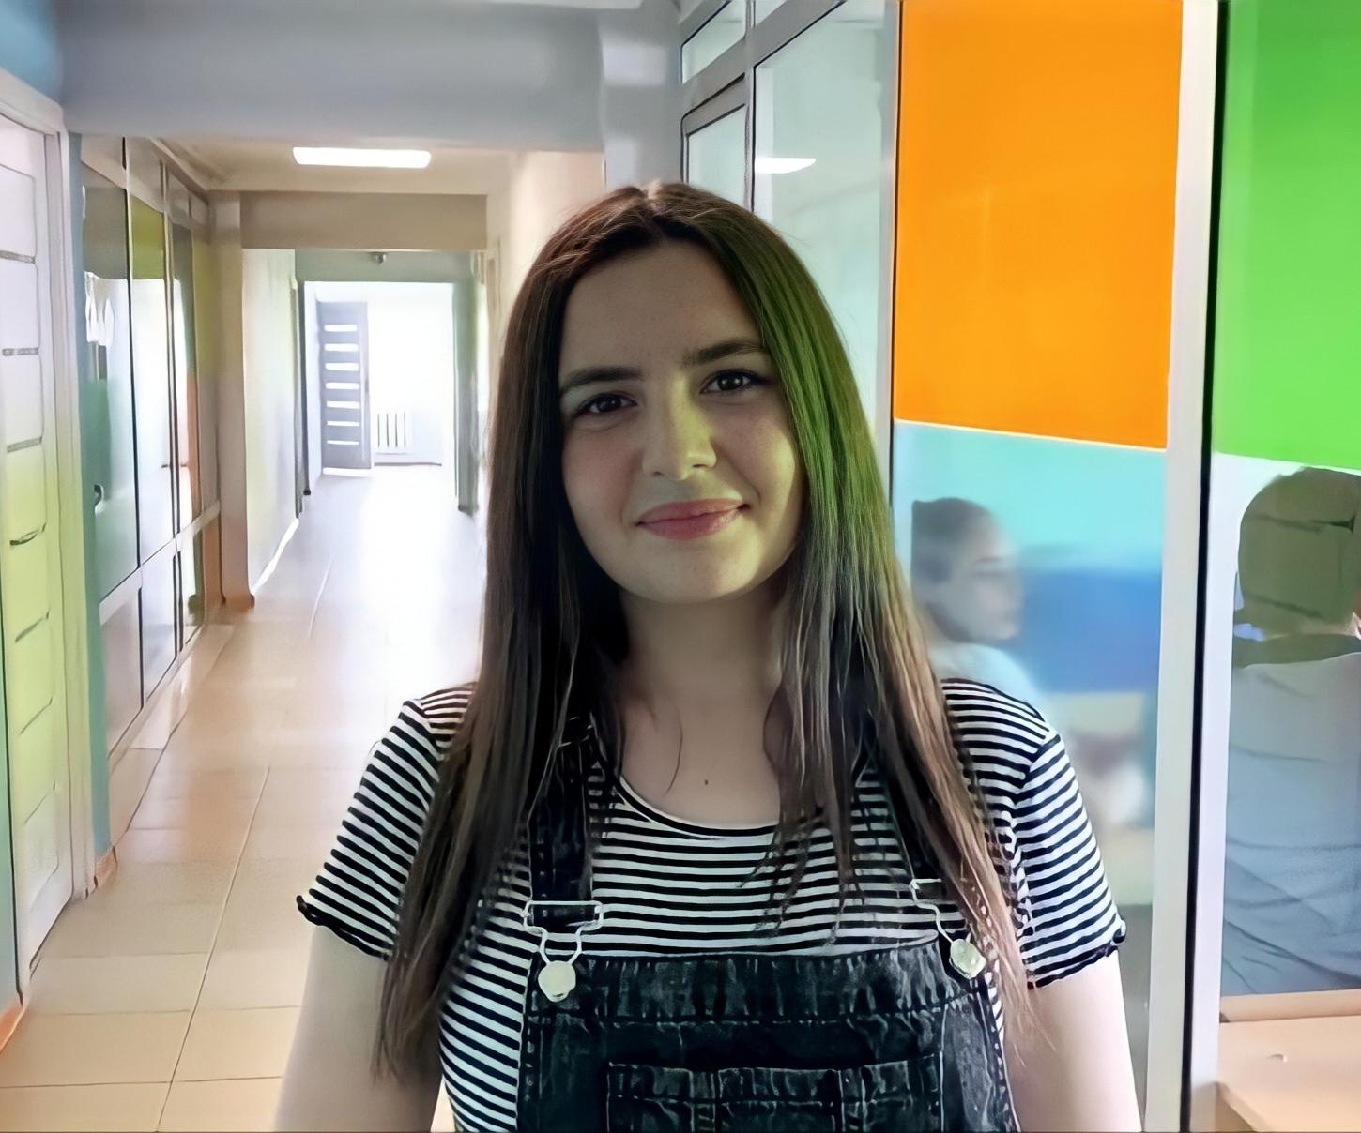
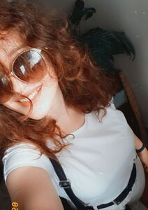
David Grigoryan
Databases
Դավիթ Գրիգորյան
Vladimir Hovakimyan
Designer, especially Logo
Վլադիմիր Հովակիմյան
Martin Hovhannisyan
UI Design
Մարտին Հովհաննիսյան
Nareh Abrahamyan
Նարէ Աբրահամյան
Organiser, lead developer
Naira Apikyan
Նաիրա Ապիկյան
Lead developer and bug fixer

Slide 28
Thanks for watching !!!!
And a special thanks to Kyle <3

Slide 29
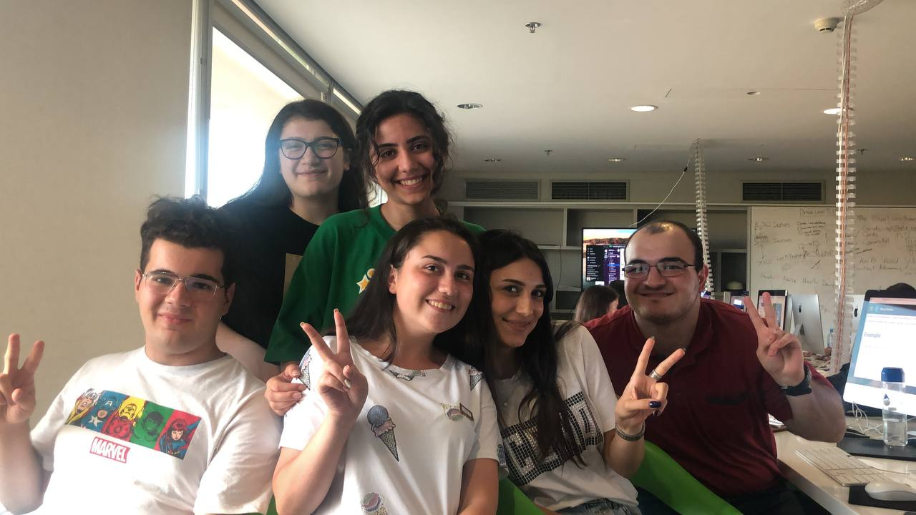
Salata

Slide 30
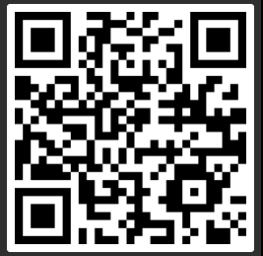
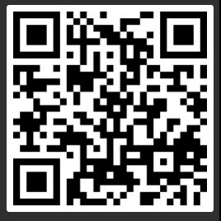
Salata App

Slide 31
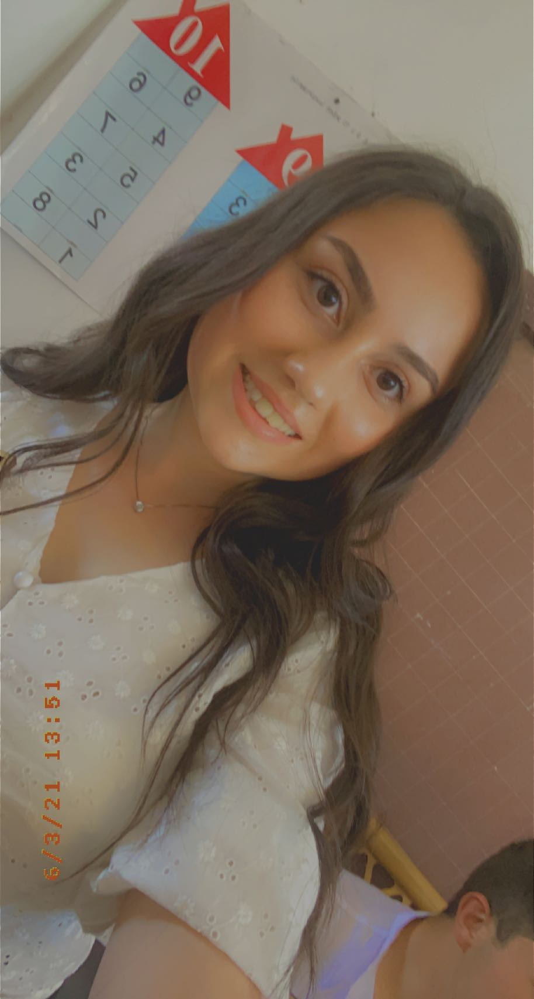
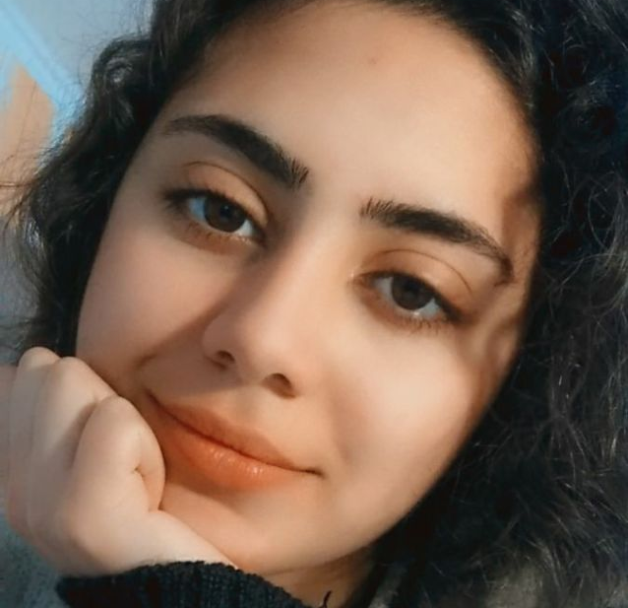
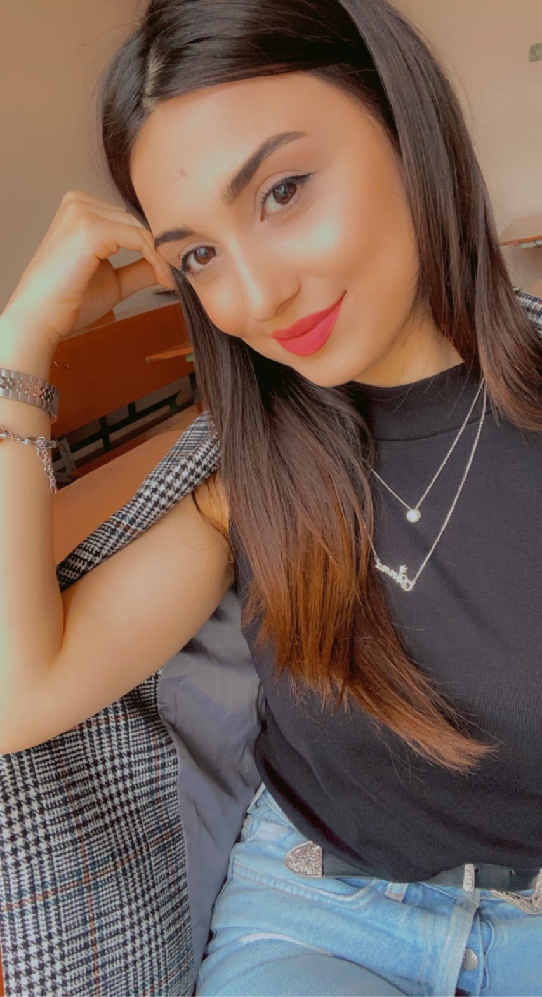
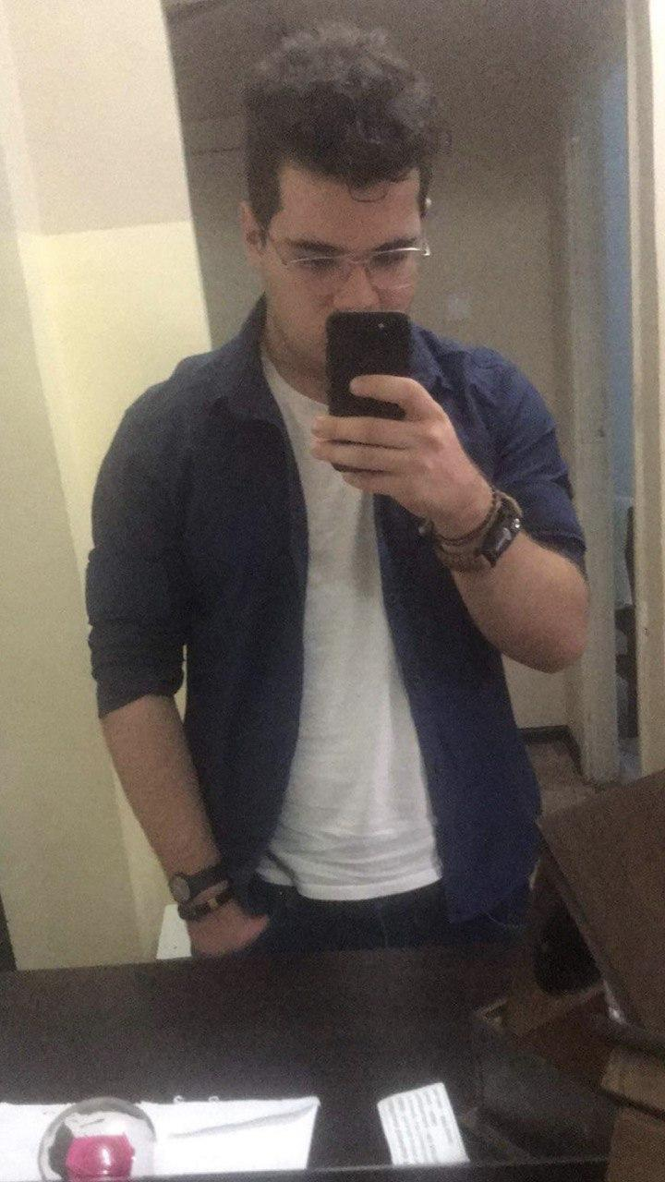
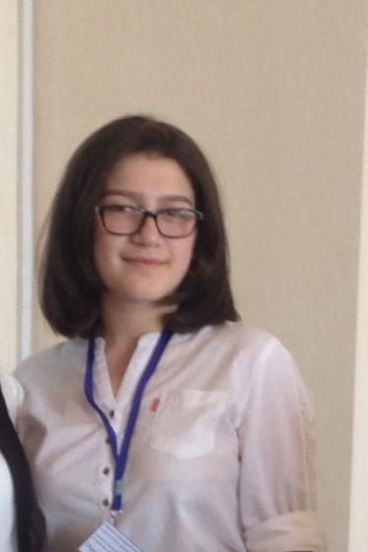
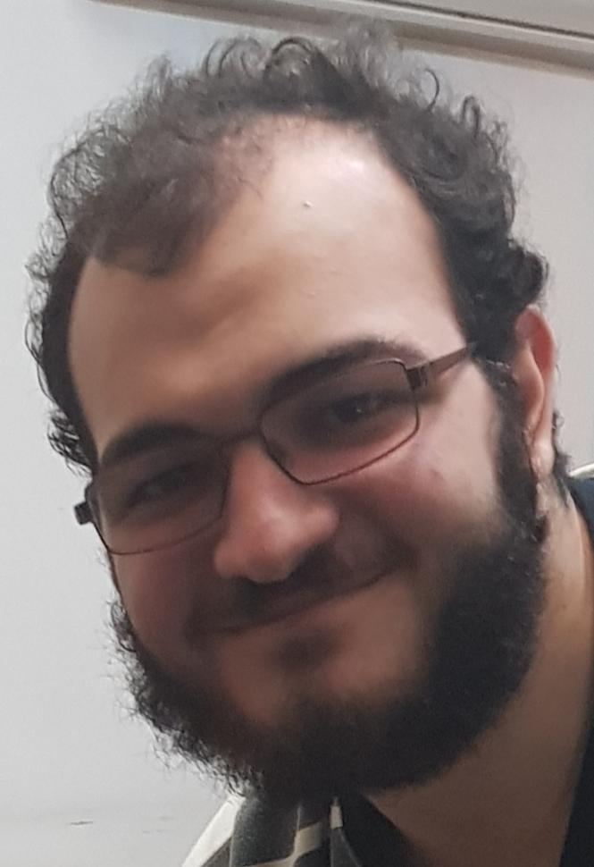
Meet Our Team
Mary
Marie
Anna
Gevorg
Melanie
Hagop

Slide 32
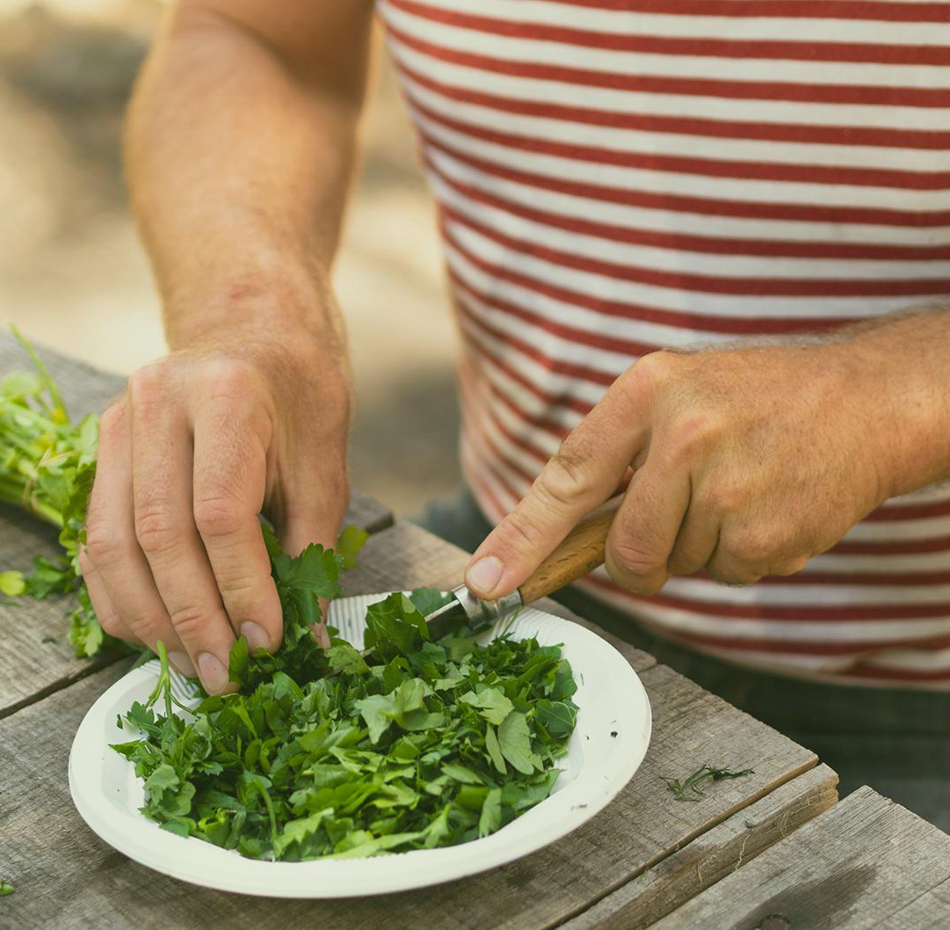
What is Salata?
Salata is a mobile application for restaurants and chefs to effectively receive and prepare orders from customers.

Slide 33
What are our benefits?
01
02
03
04
First
Second section
It has a digital menu, so you can find more about our dishes by checking out our app
Our app also has a order placement, so it will take a minute to order something from our app
Third section
Fourth section
We allow restaurants to efficiently store and track their customers’ orders
Our app allows chefs to play the recording of the orders

Slide 34
Who are our target users?
People who are hungry
People who live in the US
People who don’t have time for cooking
People who don’t know how to cook
People who are tired of cooking

Slide 35
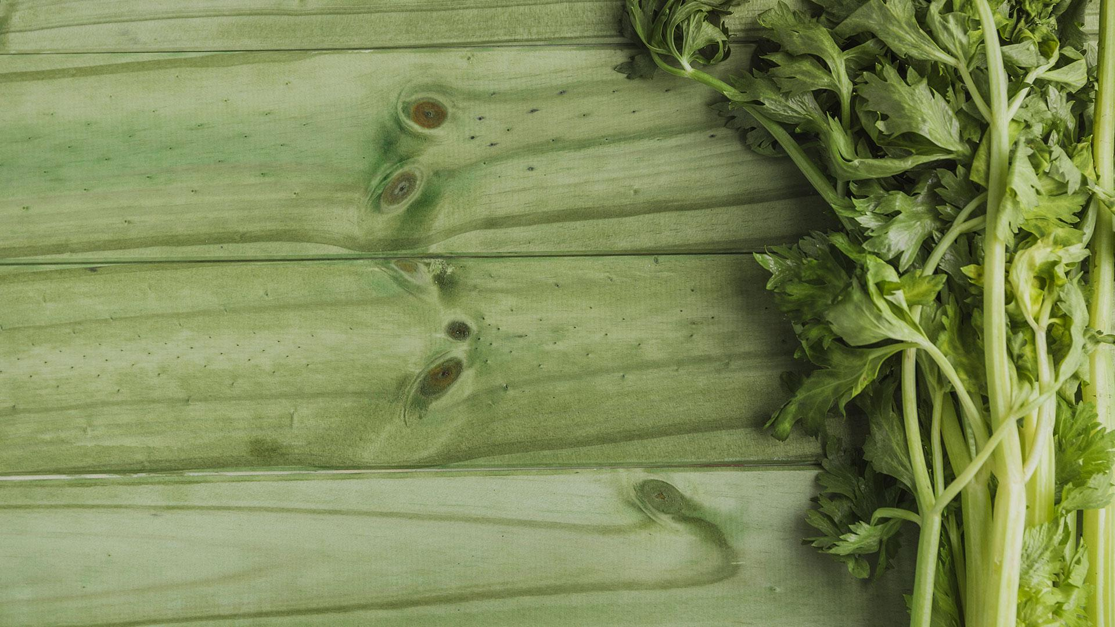
Let’s see what we did during this two weeks

Slide 36
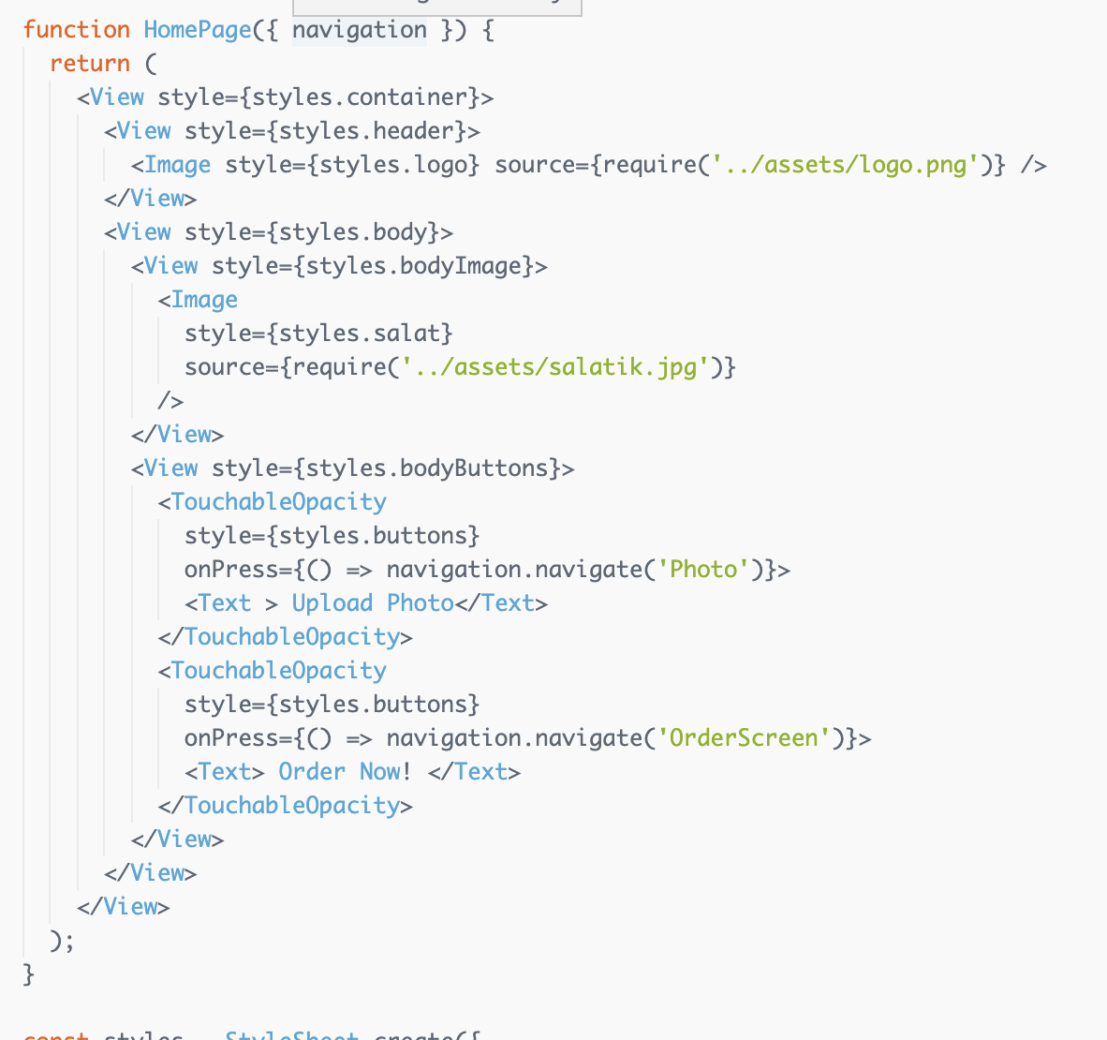
First Week
During first week, we learnt about React native and got some basic skills that helped us develop our own app.

Slide 37
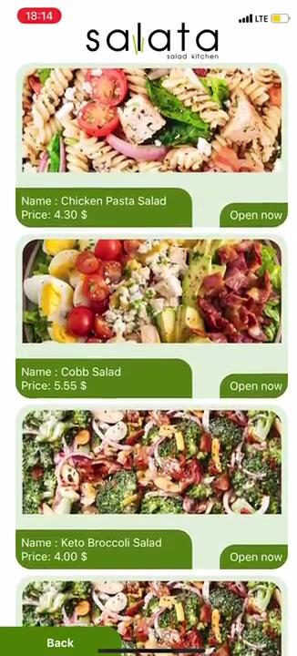
The end of Second week

Slide 38
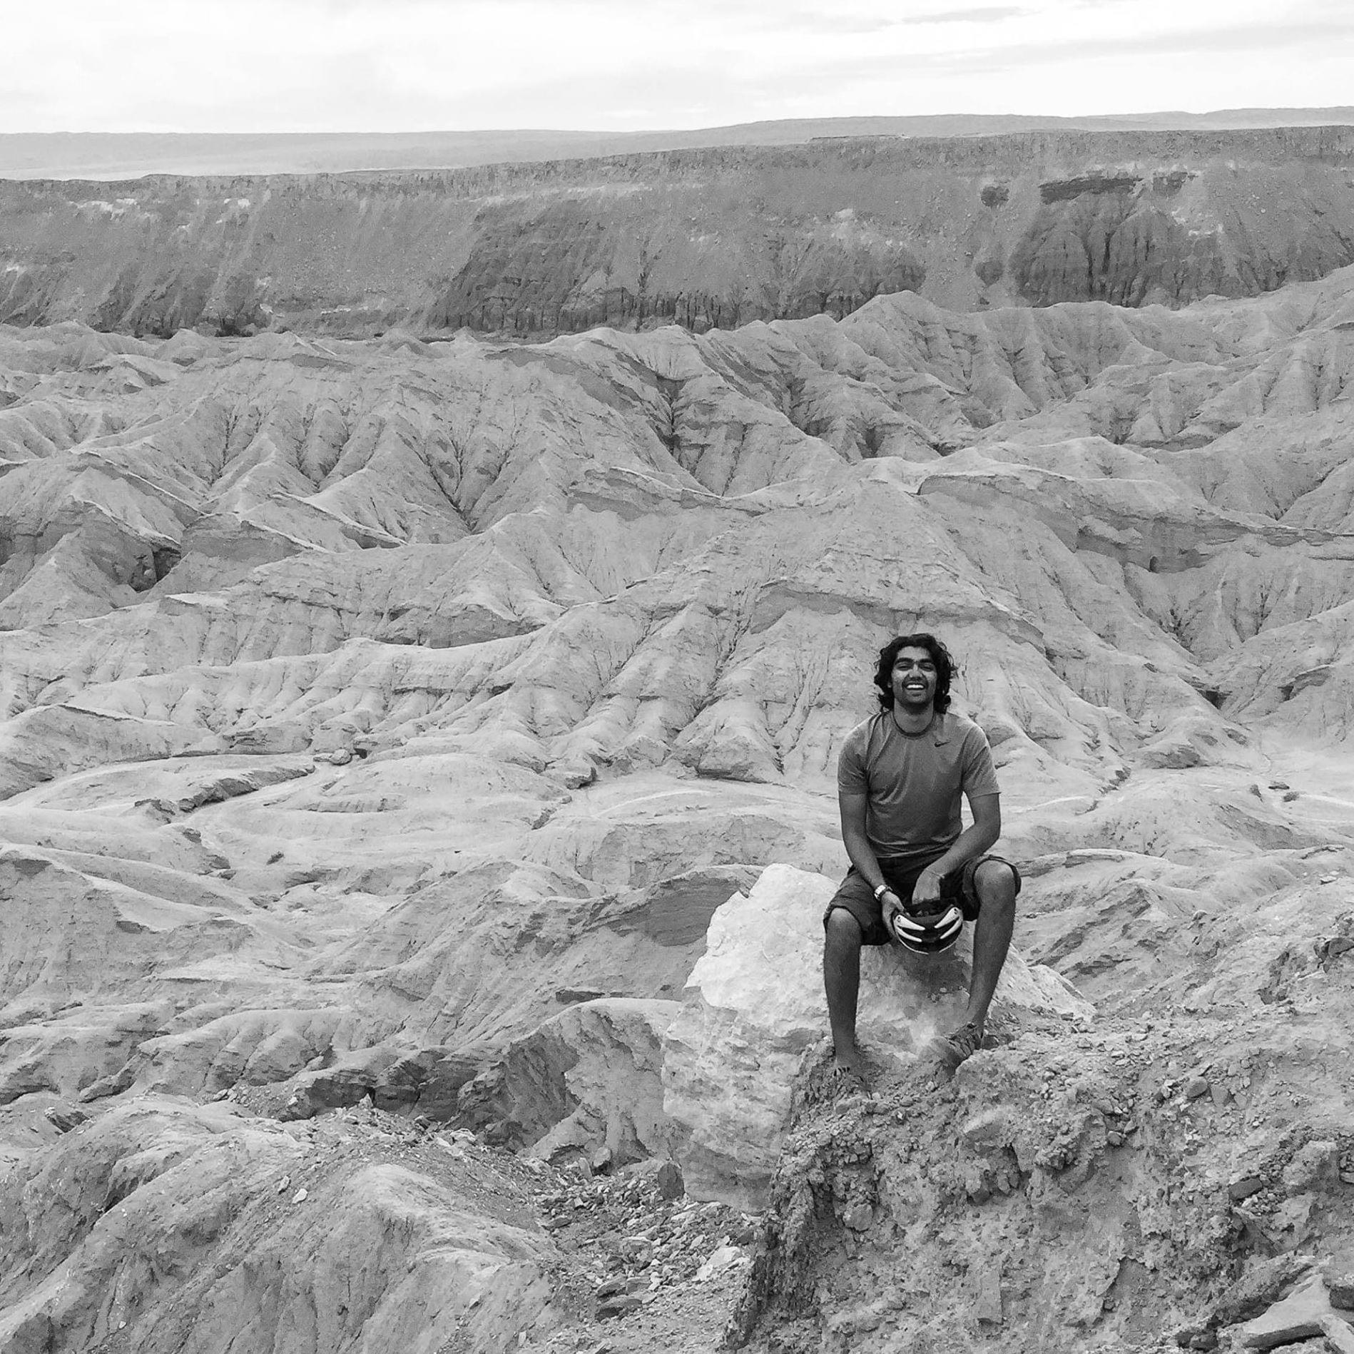
THANK YOU
Thank You Kyle for these 2 amazing, informative and funny weeks.

Slide 39
Thanks!
Slides made by: Mary Grigoryan Marie Nazaryan
Anna Hovhannisyan
Gevorg Babajanyan
Melanie Melkonyan Hagop Arslanian
Any Questions?
Please keep this slide for attribution

Slide 40
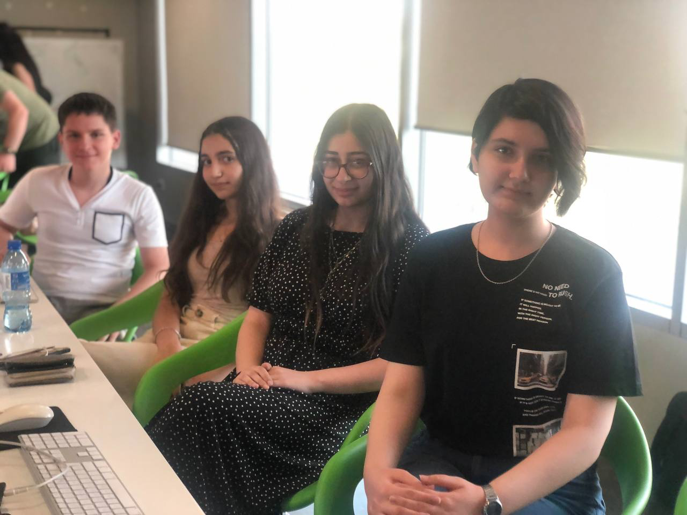
Digital Literacy

Slide 41
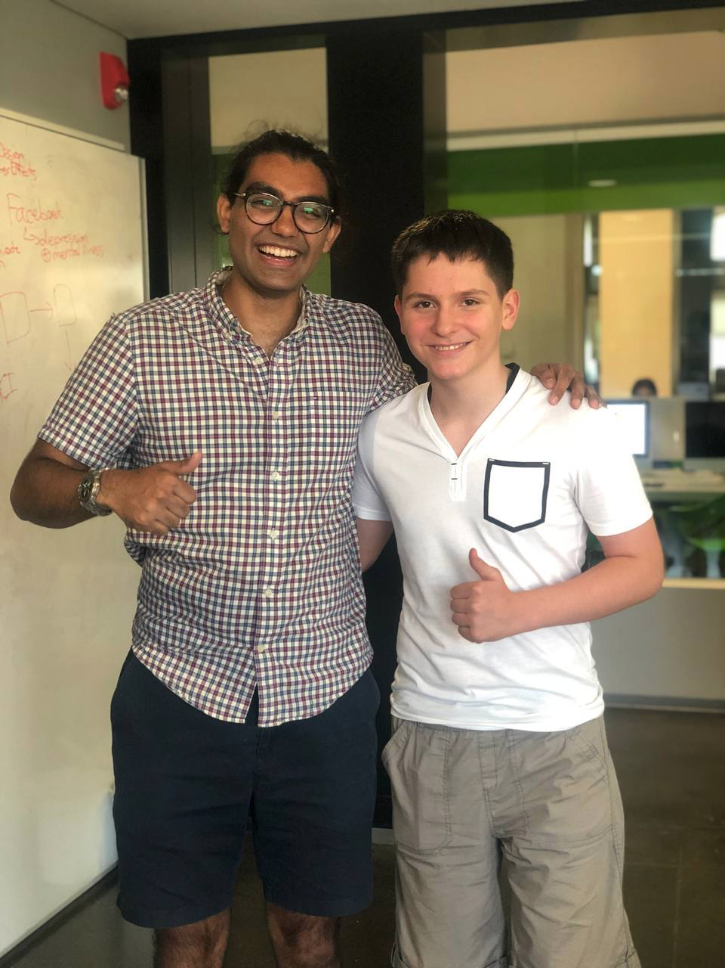





շնորհակալություն to TUMO, Coaches, and Students 🙏
Notes:
First time in Armenia

